Slide 1
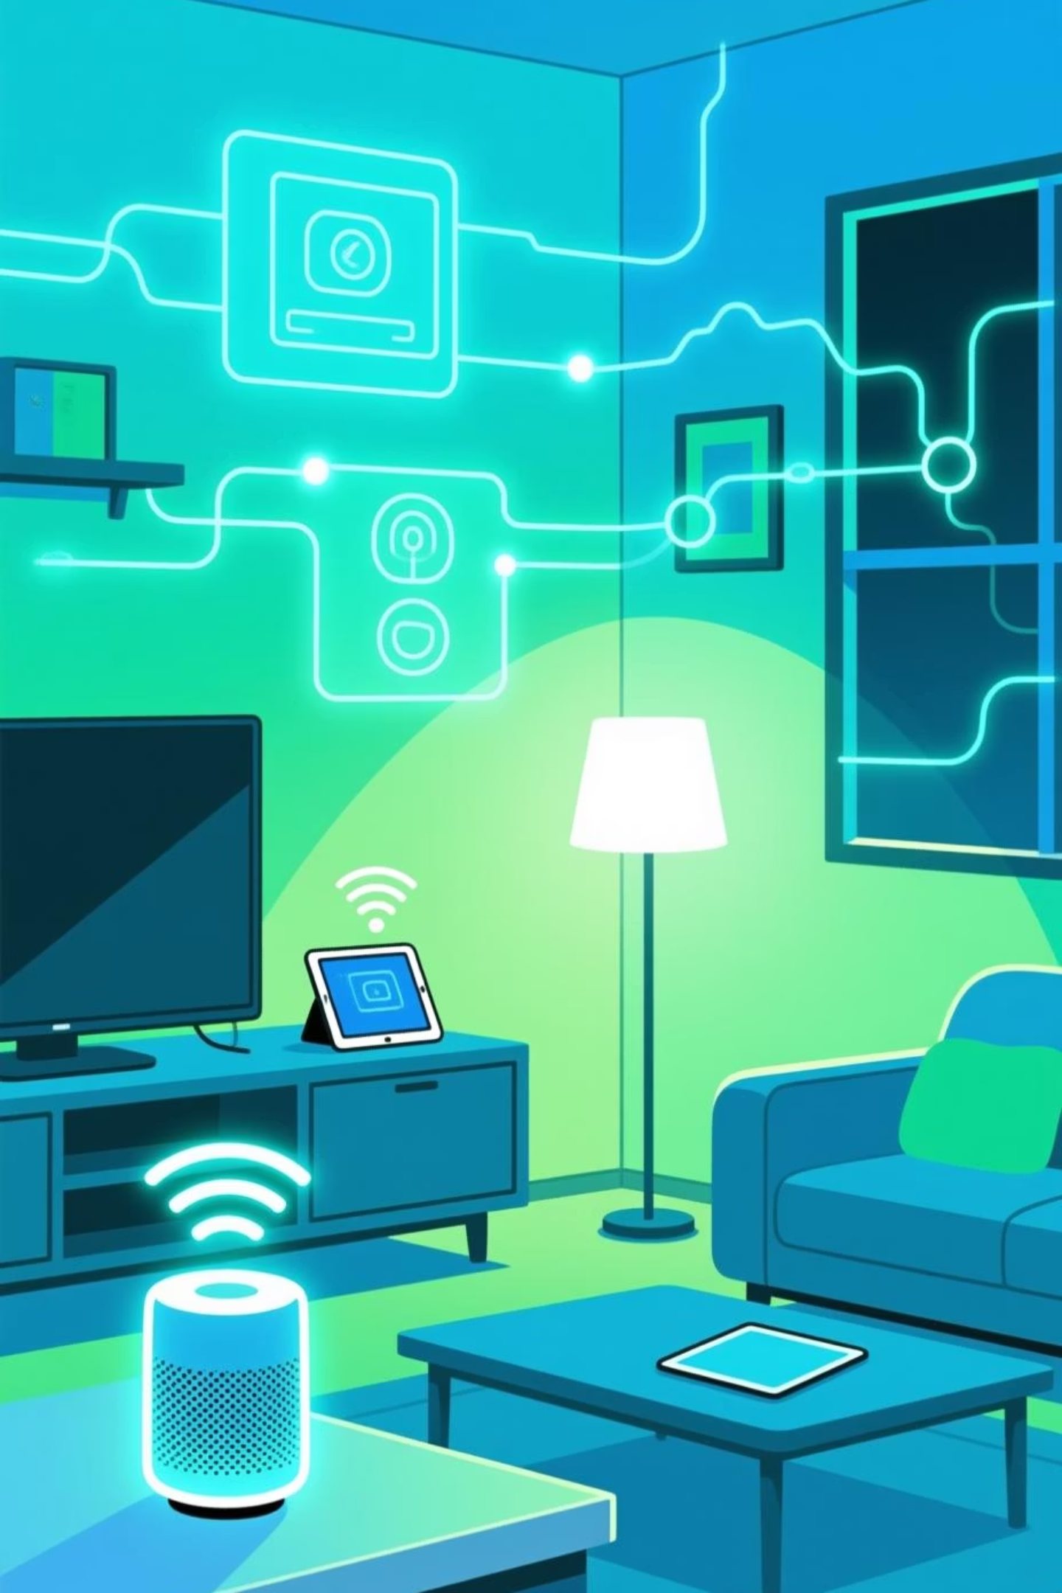
Smart Home Automation using Wi-Fi
Home Appliance Control with ESP8266
Presented by : Astuti
Year : 3rd

Slide 2




Project Objectives
Remote Control
User-Friendly Interface
Safe Appliance Control
Enable ON/OFF control of light bulbs via a web interface from phones and laptops over your local Wi-Fi network.
Provide a simple, responsive control panel that anyone can use without technical knowledge.
Demonstrate practical IoT with safe mains control via a relay module that isolates low-voltage electronics.
Success criteria: Webpage loads on any device in the same network, each bulb switches independently with immediate feedback, and all mains wiring remains safely isolated.

Slide 3
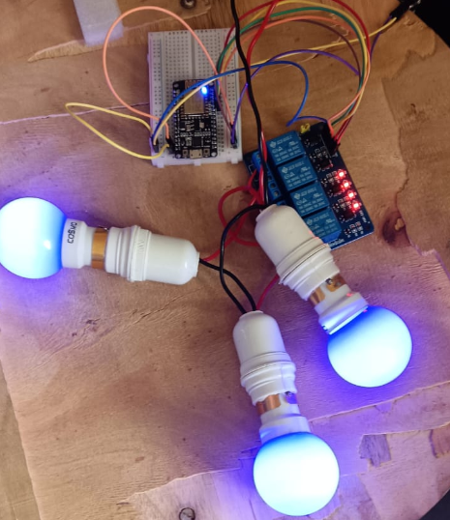
Components & Hardware Setup
ESP8266 Module
NodeMCU or WeMos variant with built-in Wi-Fi capability
4-Channel Relay Module
Isolates ESP8266 from mains voltage for safe switching
Power & Wiring
5V DC adapter, breadboard, jumper wires, and optional project enclosure
Light Bulbs
LED or incandescent bulbs (up to 4 devices)
Key connection: Relay inputs IN1–IN4 connect to ESP8266 pins D1–D4, with relay VCC/GND powered from the same 5V supply.

Slide 4
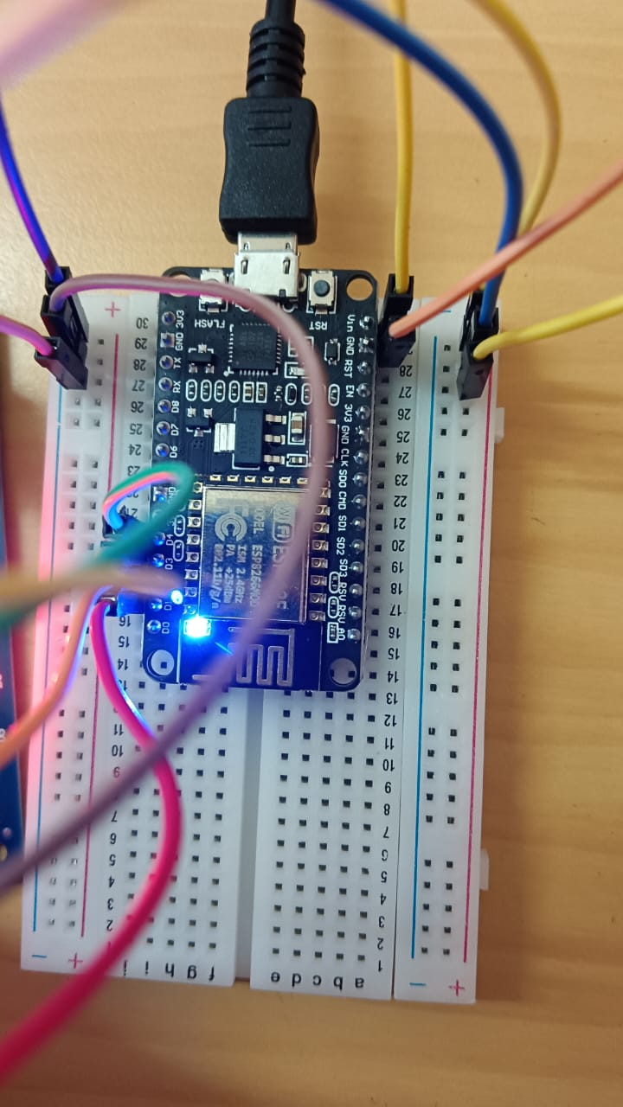
Why ESP8266?
It is a low-cost Wi-Fi microchip with full
TCP/IP stack and microcontroller
capability.
It allows microcontrollers to connect to a
Wi-Fi network and make simple TCP/IP
connections.
.
This tiny, Wi-Fi-enabled microcontroller is inexpensive, widely available, and powerful enough to run a lightweight web server—no separate hub needed
Our project controls up to four bulbs through a browser or mobile device over Wi-Fi, with a web-based control panel for ON/OFF switching and real-time status indicators.

Slide 5
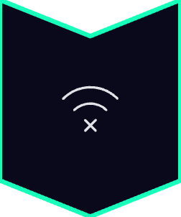




How It Works: End-to-End Flow
Wi-Fi Connection
ESP8266 connects to your home Wi-Fi network and obtains a local IP address.
Web Server Starts
A lightweight web server runs on the ESP, serving the control page to any device on the network.
User Interaction
User opens the control page on a mobile or laptop and clicks ON/OFF buttons for each bulb.
Relay Switching
ESP processes the request, updates the corresponding relay state, and toggles the GPIO pin.
Bulb Response
Relay switches, powering or cutting power to the bulb; UI updates to reflect the current state.
Local control via LAN—no dependency on cloud servers unless you choose to add that later.

Slide 6
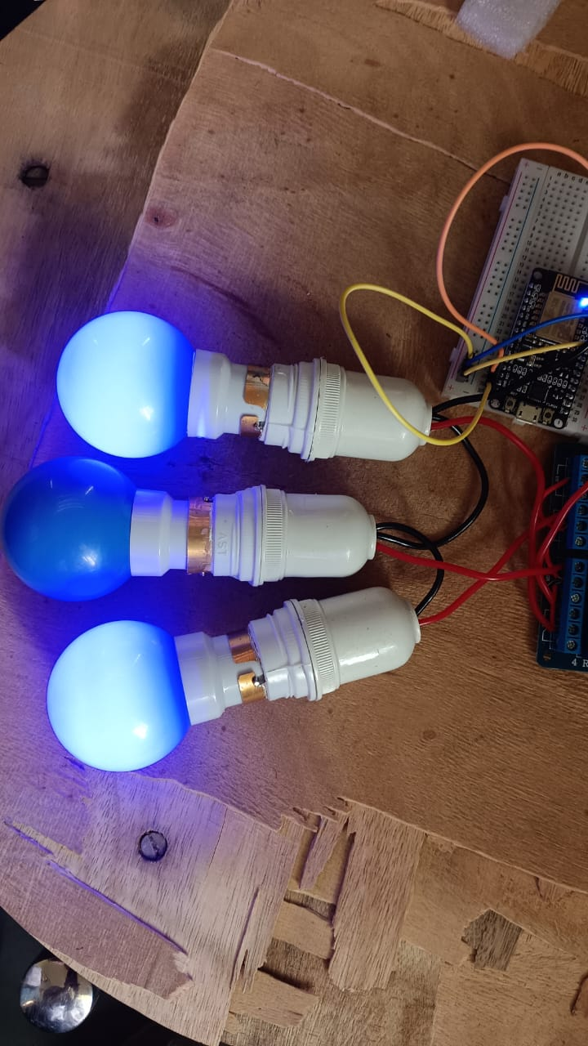
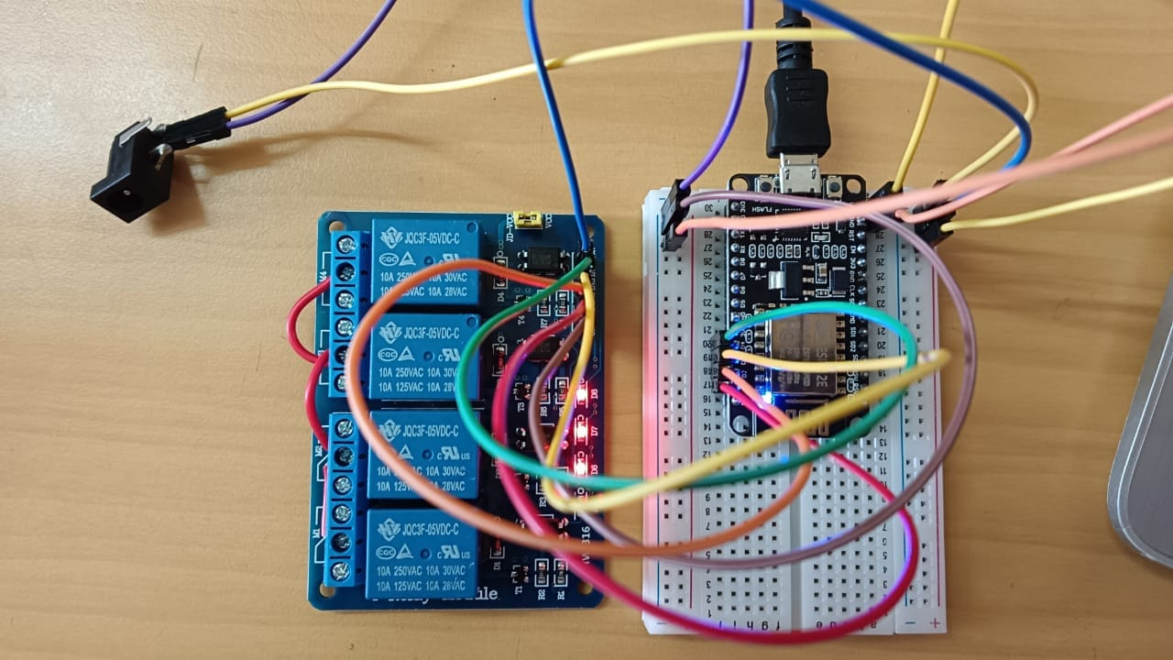
Circuit Overview
01
02
03
Low-Voltage Side
High-Voltage Side
Safety Isolation
ESP8266 GPIO pins (D1–D4) control relay inputs; VCC and GND provide 5V power to the relay board.
Bulbs connect to relay outputs; when a relay closes, it completes the mains circuit and powers the bulb.
Relay module keeps mains wiring separate from the ESP8266, ensuring safe operation. Always wire with power OFF.

Slide 7
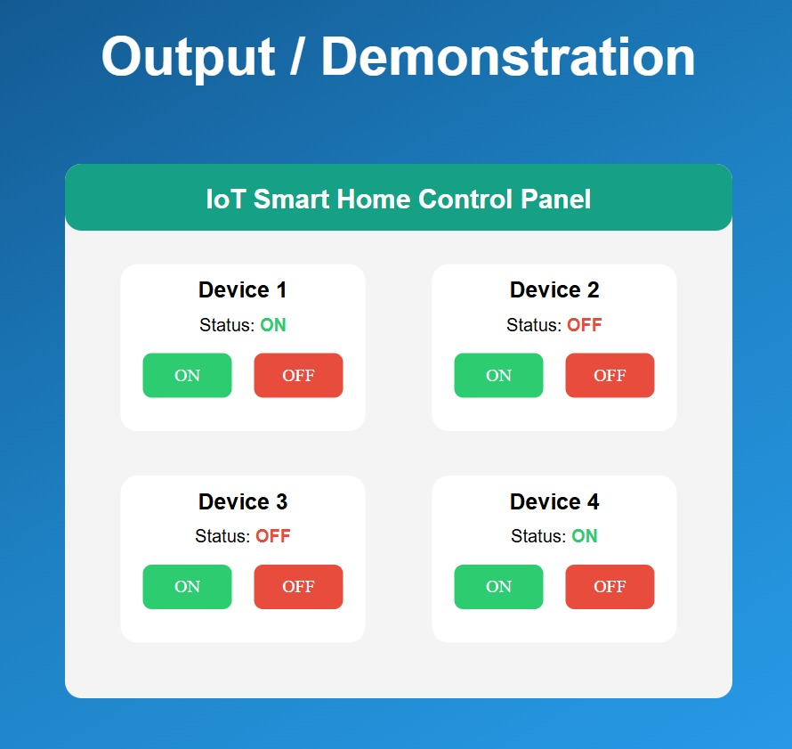
Mobile Access
Control panel loads instantly on any phone or tablet connected to the same network.
Real-Time Response
Local IP Address
Bulbs respond immediately to button clicks with visible status updates in the UI.
Access your controller at a simple address like http://192.168.1.x from any browser.

Slide 8
Advantages & Future Enhancements
Current Advantages
Remote & Local Control
Manage appliances via a simple web interface from anywhere on your network.
Cost-Effective IoT
Built with widely available, affordable components—perfect for hobbyists and learners.
Scalable Foundation
Easily add more devices, sensors, or automation logic with the same core approach.

Slide 9
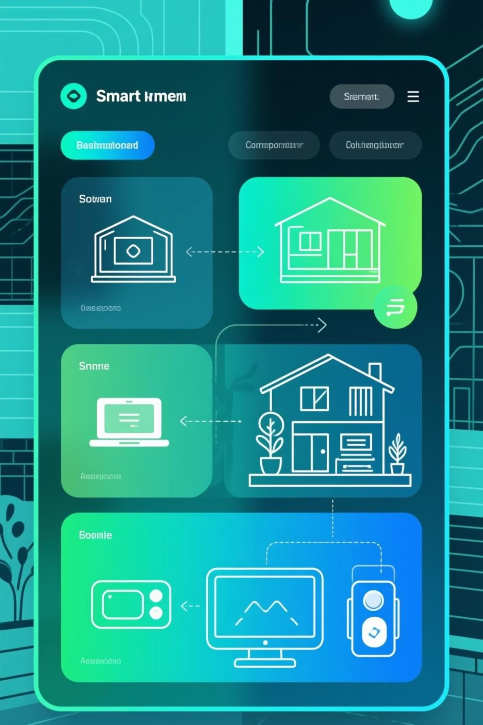
Conclusion:
This project demonstrates a practical, Wi-Fi-enabled control system for home lighting that's affordable, extensible, and educational. You've seen how a simple ESP8266 and relay module create a foundation for smart-home experimentation—with web-based UI, 4-channel control, safe mains switching, and local network operation.

Slide 10


